Slide 1
RESTful ws

Slide 2
Agenda
RESTful webservices
Implementation of RESTful webservices
SOAP vs. REST
Why SOAP?
Why REST?
Q&A

Slide 3
HTTP Protocol
Lets use standard HTTP protocol.
It can be accessed via a URL (Uniform Resource Locator) like
http://www.vendorx.com/products/x123
It has standard methods to
Retrieve ( GET )
Create ( POST )
Update ( PUT )
Delete (DELETE )
Payload can be directly added to http message. No need to wrap it in another protocol.

Slide 4
RESTful web services
REpresentational State Transfer
It is a simple stateless architecture that generally runs over HTTP.
The focus is on a resource in the system
Ex: an Employee, an Account, a Product etc.
Each unique URL is a representation of some object
Ex : http://www.vendorx.com/products
http://www.vendorx.com/products/x123
HTTP methods (GET/POST/…) operates on the resource.
Object state is transferred and stored at client.
Representation of the resource state in XML, JSON etc.

Slide 5
RPC vs REST
RPC
Every object has its own unique methods
Methods can be remotely invoked over the Internet
A single URI represents the end-point, and that's the only contract with the Web
Data hidden behind method calls and parameters
Data is unavailable to Web applications
REST
Every useful data object has an address
Resources themselves are the targets for method calls
The list of methods is fixed for all resources

Slide 6
RESTful web services contd…
Principles
Resource identification through URI
Uniform interface
GET/PUT/POST/DELETE
Self-descriptive messages
Stateless interactions through hyperlinks
Benefits
Server side
Uniform Interface
Cacheable
Scalable
Easy failover
Client side
Easy to experiment in browser
Broad programming language support
Choice of data formats
bookmarkable

Slide 7
Six characteristics of REST:
Uniform interface
Decoupled client-server interaction
Stateless
Cacheable
Layered
Extensible through code on demand (optional)
* Services that do not conform to the above required contstraints are not strictly RESTful web services.

Slide 8
Product service as RESTful
Request
GET /products/X123 HTTP/1.1
Host: vendorx.com
Accept: application/xml
Response
HTTP/1.1 200 OK
Date: Tue, 09 Feb 2010 11:41:20 GMT
Server: Apache/1.3.6
Content-Type: application/xml; charset=UTF-8
<?xml version="1.0"?>
<Products xmlns="…">
<Product id=“X123”>
…
</Product>
</Products>
Method
Resource
State
transfer
Representation

Slide 9
Developing a RESTful web service using JAX-RS
package com.vendorx.products;
import javax.ws.rs.GET;
import javax.ws.rs.Produces;
import javax.ws.rs.Path;
@Path("/employees/{pid}")
public class Product{
@GET
@Produces("text/xml")
public String getProduct(@PathParam(“pid") String pId) {
...
…
}
}

Slide 10
JAX-RS REST Annotations
Annotation | Description
@Path | The @Path annotation's value is a relative URI path indicating where the Java class will be hosted, for example, /helloworld. You can also embed variables in the URIs to make a URI path template. For example, you could ask for the name of a user, and pass it to the application as a variable in the URI, like this, /helloworld/{username}.
@GET | The @GET annotation is a request method designator and corresponds to the similarly named HTTP method. The Java method annotated with this request method designator will process HTTP GET requests. The behavior of a resource is determined by the HTTP method to which the resource is responding.
@POST | The @POST annotation is a request method designator and corresponds to the similarly named HTTP method. The Java method annotated with this request method designator will process HTTP POST requests. The behavior of a resource is determined by the HTTP method to which the resource is responding.
@PUT | The @PUT annotation is a request method designator and corresponds to the similarly named HTTP method. The Java method annotated with this request method designator will process HTTP PUT requests. The behavior of a resource is determined by the HTTP method to which the resource is responding.
@DELETE | The @DELETE annotation is a request method designator and corresponds to the similarly named HTTP method. The Java method annotated with this request method designator will process HTTPDELETE requests. The behavior of a resource is determined by the HTTP method to which the resource is responding.

Slide 11
JAX-RS REST Annotations
Annotation | Description
@HEAD | The @HEAD annotation is a request method designator and corresponds to the similarly named HTTP method. The Java method annotated with this request method designator will process HTTP HEAD requests. The behavior of a resource is determined by the HTTP method to which the resource is responding.
@PathParam | The @PathParam annotation is a type of parameter that you can extract for use in your resource class. URI path parameters are extracted from the request URI, and the parameter names correspond to the URI path template variable names specified in the @Path class-level annotation.
@QueryParam | The @QueryParam annotation is a type of parameter that you can extract for use in your resource class. Query parameters are extracted from the request URI query parameters.
@Consumes | The @Consumes annotation is used to specify the MIME media types of representations a resource can consume that were sent by the client.
@Produces | The @Produces annotation is used to specify the MIME media types of representations a resource can produce and send back to the client, for example, "text/plain".

Slide 12
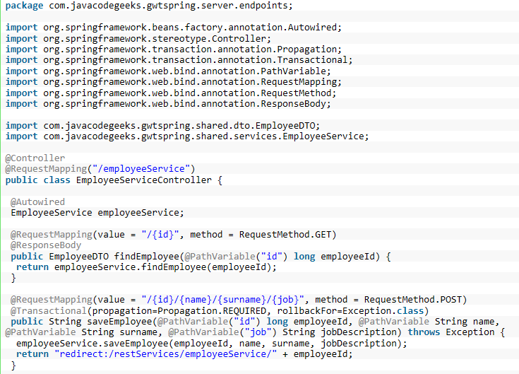
Using Spring framework

Slide 13


Arguments: SOAP vs. REST
SOAP based webservices are too complex for a web based service.
How about transactions and reliability in REST?
SOAP based webservices are protocol independent.
REST operations are limited (only http methods)
SOAP has built-in error handling.
REST is easy to test (in any browser)
SOAP is not only for Web.
REST development is faster and easier.

Slide 14
Arguments: SOAP vs. REST
REST has better performance and scalability.
SOAP has many extensions built WS-* (security, transaction etc.)
A service offered in a REST style will be easier to consume than some complex API:
Lower learning curve for the consumer
Lower support overhead for the producer
What happens when you need application semantics that don't fit into the GET / PUT / POST / DELETE generic interfaces and representational state model?
These interfaces are sufficiently general. Other interfaces considered harmful because they increase the costs of consuming particular services

Slide 15
Why REST?
Exposing a public API over the internet to handle CRUD operations on data.
REST permits many different formats like XML, JSON etc.
REST reads can be cached.
REST is concise. No need of additional messaging layer.
REST is stateless. If an operation needs to be continued just REST doesn’t help.
Easy to test (in any browser, no need of a new client to write)
REST is particularly useful for restricted-profile devices such as mobile and PDAs for which the overhead of additional parameters like headers and other SOAP elements are less.

Slide 16
Why SOAP?
SOAP is not only for Web. It has its own protocol.
SOAP Exposes application logic (not data) as service. Exposes named operations.
Can implement stateful web services.
SOAP Web services are useful in handling asynchronous processing and invocation.
SOAP has additional feature built on top of it which REST doesn’t.
WS-Security
WS-Reliable Messaging
WS-Atomic Transactions
Most real-world applications are not simple and support complex operations, which require conversational state and contextual information to be maintained. With the SOAP approach, developers need not worry about writing this plumbing code into the application layer themselves.

